Slide 1
META AI HACKATHON 2026
ElasticShelf
Margin recovery via algorithmic pricing for enterprise grocers.

Slide 2
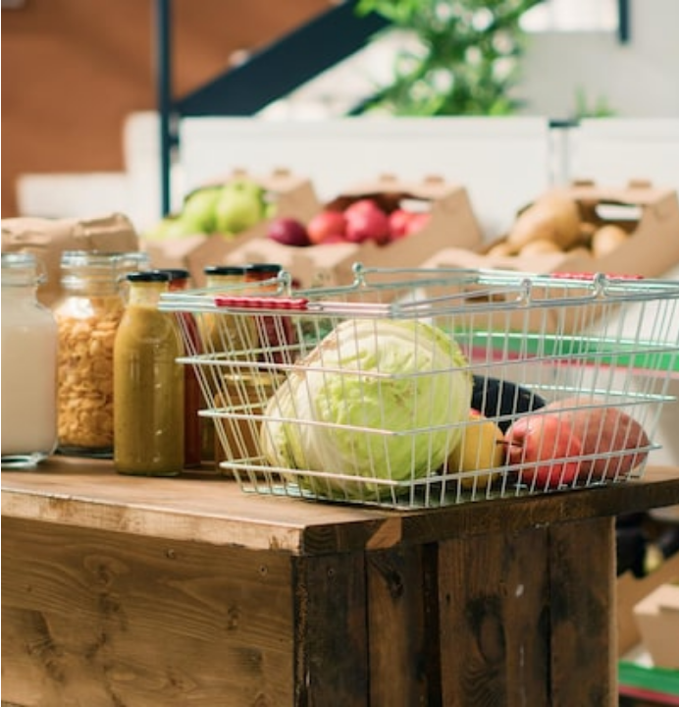
The Margin Drain
Static pricing models destroy perishable inventory margins.
1.05B Tonnes: Global annual food waste.
5% Average Shrink: Retail fresh grocery losses.
Static Rules: Arbitrary markdown timing fails.

Slide 3
THE MARKET OPPORTUNITY
$7.3B
$1.2B
$150M
ESL Market by 2033
US/EU Fresh Grocery IT
Top 50 Regional Chains

Slide 4
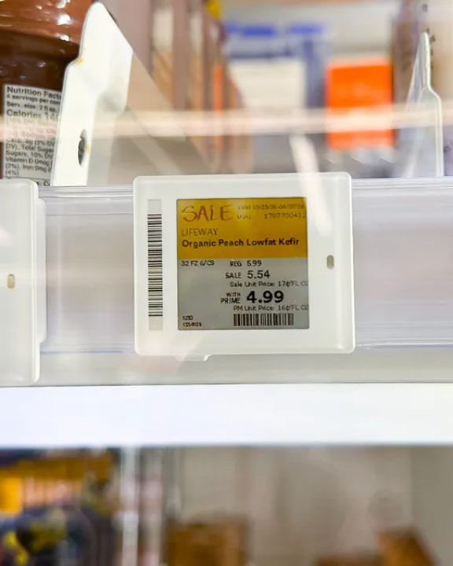
Algorithmic Yield Engine
Transforming static digital tags into dynamic clearance tools.
Hardware Agnostic
Connects to any existing ESL network.
Zero Added Labor
Fully automated remote price updates.
Margin Recovery
Immediate ROI for enterprise CFOs.

Slide 5



Built on Meta AI
LLaMA 3 70B
PyTorch RL
FAISS Vector DB
Ingests local demand signals.
Calculates real-time price elasticity.
Retrieves historical clearance data.

Slide 6
The Data Flywheel
1
2
3
4
Baseline
Reactive Pricing
Learning Phase
Proactive Prevention
Tracks exact shelf inventory.
Drops price before spoilage.
Records discount effectiveness.
Recalibrates automated purchasing.

Slide 7
01
Middleware Connect
Bypass legacy POS environments entirely.
Seamless Integration
02
POS Marketplace App
Standard enterprise API integrations.
Three frictionless deployment pathways. Bypassing legacy constraints.
03
Direct ESL Bridge
Updates physical retail tags directly.

Slide 8
Competitive Moat
Feature | ElasticShelf | Wasteless | Shelf Engine
Mechanism | End-to-End Flywheel | Pricing Only | Forecasting Only
Architecture | LLaMA + PyTorch | Proprietary RL | Machine Learning
Integration | Headless API | High Friction | Medium Friction

Slide 9

Revenue Model
SaaS + API Usage
Base monthly fee per retail location.
Shared-Value Upsell
10% performance cut of recovered margins.

